Slide 1
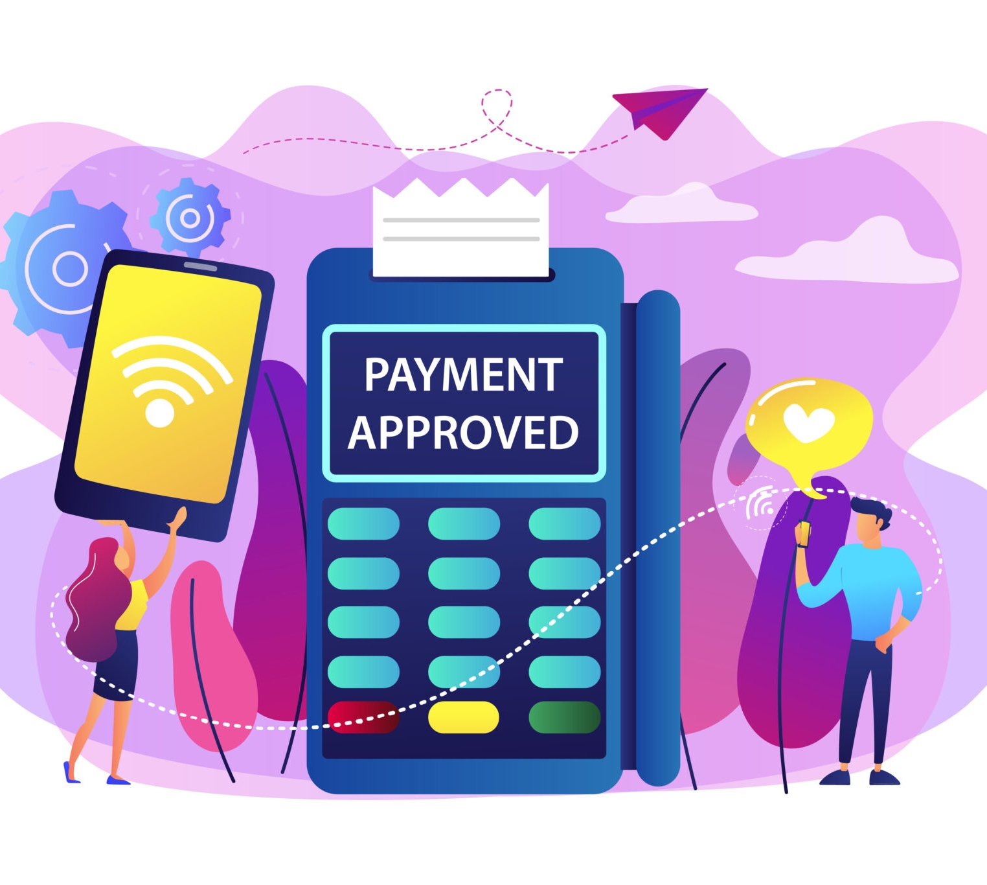

Use Case Presentation
NACH Automation
Dwaipayan Dutta

Slide 2

Project Overview
Deep Dive into use case and Details
NACH Automation
Utilising Large Language Models (LLMs) and image recognition services is a cutting-edge B2B SaaS platform that revolutionizes the lead-to-issuance workflow. It enables organizations to automate complex processes, such as mandate form processing and verification, thereby significantly boosting operational efficiency. The platform also enhances the customer experience by streamlining interactions, reducing manual intervention, and supporting seamless, secure transactions through automated mandate form handling and validation workflows.
Business Context | NACH:
The business context for NACH automation using LLM and image recognition services revolves around the increasing need for organizations, particularly in banking and financial services, to optimize payment and transaction processes. Traditional manual handling of mandate forms, verification, and data entry is often time-consuming, error-prone, and costly. Organizations are seeking intelligent automation solutions to improve operational efficiency, reduce processing times, and enhance customer satisfaction.
The Challenge:
Manual Errors and Delays: Traditional NACH involves manual handling of mandate forms, data entry, and verification, which can lead to errors, processing delays
Technical Glitches: Failures due to technical issues like server downtime, network problems, or authentication failures
Incorrect or Insufficient Data
Complex Mandate Management

Slide 3
NACH-AI-Powered Solution
Intelligent parsing using PyMuPDF for PDFs, Nuance/PaddleOCR for images.
LLM-based extraction converts documents to structured JSON.
Prompt engineering with advanced models (GPT-4V) boosts accuracy up to 98%.
Existing Solution Landscape
Manual effort remains high due to template changes.
Traditional regex-based solutions require frequent rewrites, with only 55% template coverage..
Impact & Results
Automation addresses critical challenges by drastically reducing manual errors and delays, leading to faster and more accurate mandate validation. It ensures high compliance with regulatory standards, minimizes transaction failures, and lowers operational costs. Consequently, organizations experience streamlined workflows, improved customer satisfaction through timely payments, and enhanced scalability to handle high volumes of recurring transactions efficiently.

Slide 4

Solution Overview
Deep Dive into use case and Details
01
Document Capture
Digitally capture scanned images or PDFs of NACH mandate forms submitted by customers.
03
Text Extraction
Apply OCR via Ollama Vision models to accurately extract textual content from the mandate forms, including customer and bank details.
02
LLM-Based Data Parsing
Utilize a Large Language Model to intelligently parse extracted text, identifying and classifying key fields like account numbers, names, and mandate-specific information.
04
Image Preprocessing
Use Ollama Vision to enhance and normalize the mandate form images for optimal readability and data extraction...

Slide 5
Solution Overview
Deep Dive into use case and Details
05
IFSC Code Verification
Cross-reference parsed IFSC codes with the official RBI database to validate and correct bank branch codes automatically..
07
JSON Generation
Structure the verified and parsed data into a standardized JSON format that captures all relevant mandate details and validated IFSC codes.
Data Validation and Error Detection
Run automated checks for data completeness, format accuracy, and consistency to detect errors or missing information.
06
Integration and Workflow Automation
Feed the JSON output into backend systems or workflows for mandate approval, status tracking, and automated payment processing.
08

Slide 6











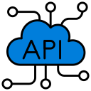




Architecture Design
Deep Dive into use case and Details
Smarter NACH, Zero Touch---------------
Stage Overview
Document Upload:
The user uploads a NACH document in either PDF or JPEG format via the designated API endpoint.
Text Extraction :
Azure Document Intelligence Service is used to extract text from various fields in the invoice via advanced OCR and layout analysis, capturing line items, dates, amounts, customer IDs, and reference numbers.
Document Classification:
The extracted text and document features are passed to a classification module that identifies the document type (e.g., NACH, KYC, PAN etc). This step ensures the correct extraction logic is applied for each unique NACH document.
Field Extraction via OpenAI LLM:
An OpenAI Large Language Model processes the raw extracted text to intelligently parse and extract all required invoice fields. The LLM handles table structures, variable invoice layouts, and subtle field variations that can challenge conventional rule-based parsers..
Output Stage :
All results extracted fields are compiled into a JSON object for downstream consumption, storage, or verification. The JSON contains structured field values
Data Sources
User
PDF and Images
Text Extraction
Model Development
Model Data Pipeline
Wrongly Classified Images
Image Model
Validate
Clean
Label
Create
UI/UX
API and Load Balancing
LLM
Real Time API
Load Balancer
Front End
Repository

Slide 7
Thank You!!

Slide 8
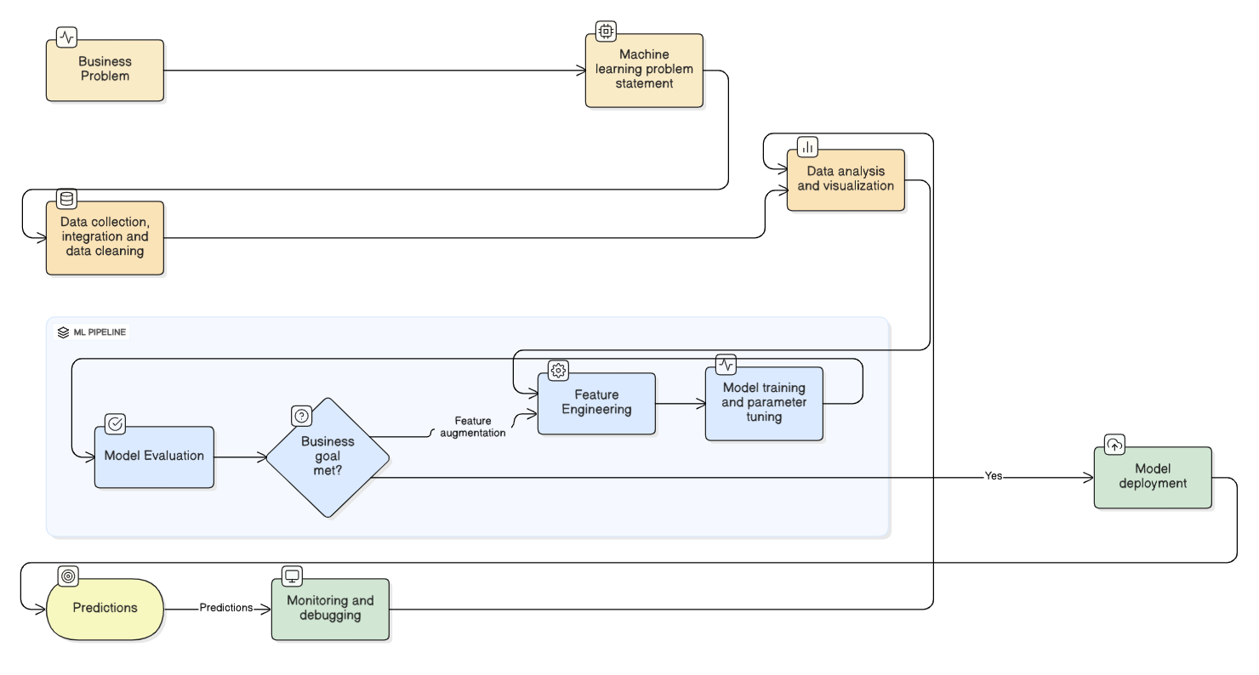
Architecture Design
Deep Dive into Data Science Architecture
Typical Flow – All Models [Onboarding, Propensity, Lapsation, Income Estimation etc.]
Business Problem and Statement
Begin by identifying a business problem and confirming that applying machine learning is an appropriate solution.​
Data Collection, Integration, and Cleaning
Gather data from multiple sources, integrate it, and clean it for analysis.​
Training sets are used to build models, validation sets assess initial model performance, and test sets evaluate how the model performs in real-world scenarios.
Data Analysis and Visualization
Conduct exploratory data analysis (EDA) to understand data quality, structure, discrepancies, and patterns.​
Feature Engineering
Create new features by transforming, scaling, or combining existing data using statistical or machine learning techniques.​
Model Training and Parameter Tuning
Train machine learning models with the available features, then tune their hyperparameters to achieve target performance metrics.​
Model Evaluation and Deployment
Select the best-performing model based on evaluation results and deploy it for business use.​
Monitoring and Debugging
Continuously monitor the deployed model, since its performance may degrade as data and business contexts change.​

